Slide 1
Transformations:
reflection
rotation
translation
enlargement
Can you identify how the red shape has been transformed into the blue shape in each slide?

Slide 2
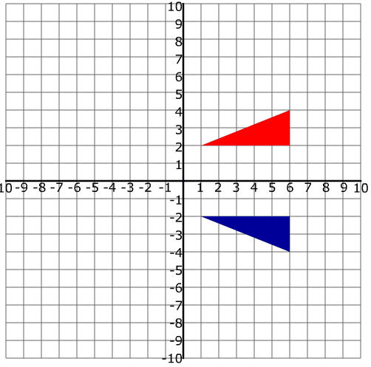
Reflection

Slide 3
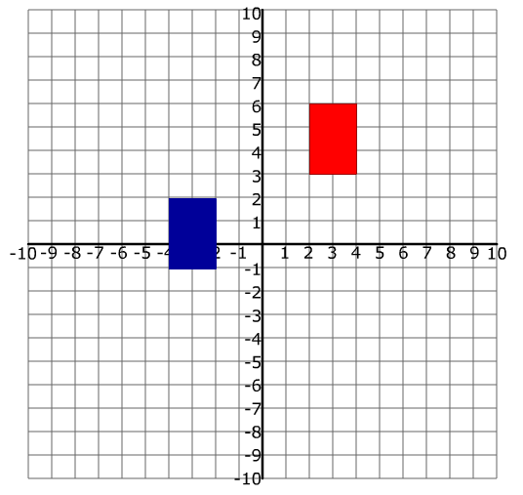
Translation

Slide 4
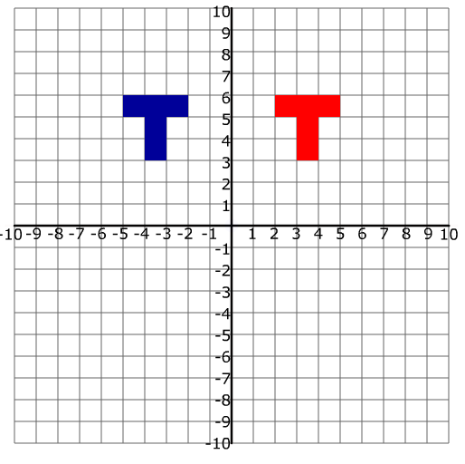
Reflection

Slide 5
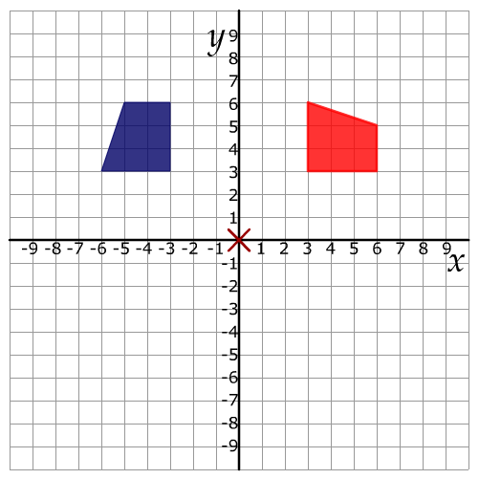
Rotation

Slide 6
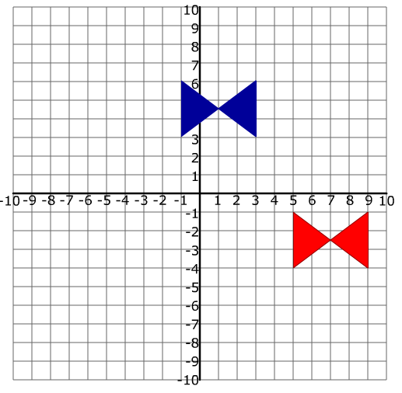
Translation

Slide 7
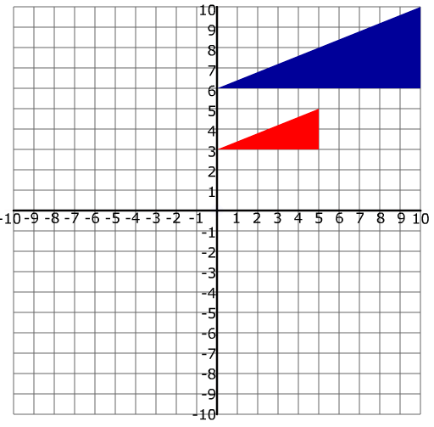
Enlargement

Slide 8
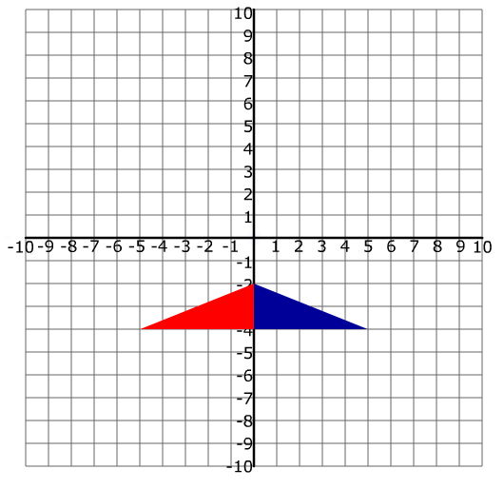
Reflection

Slide 9
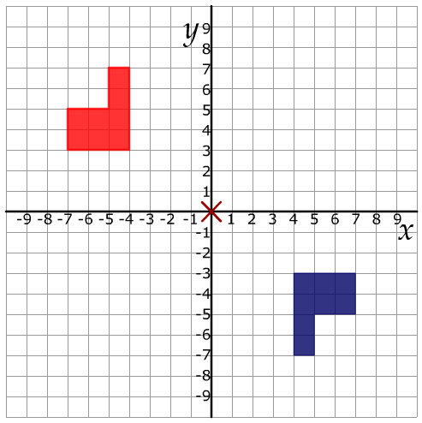
Rotation

Slide 10
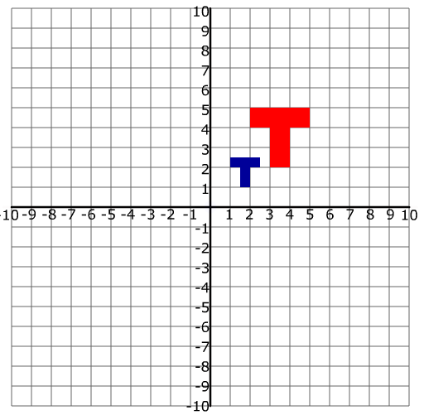
Enlargement

Slide 11
What do you notice?
In each of the transformations:
What stays the same?
What changes?

